Slide 1
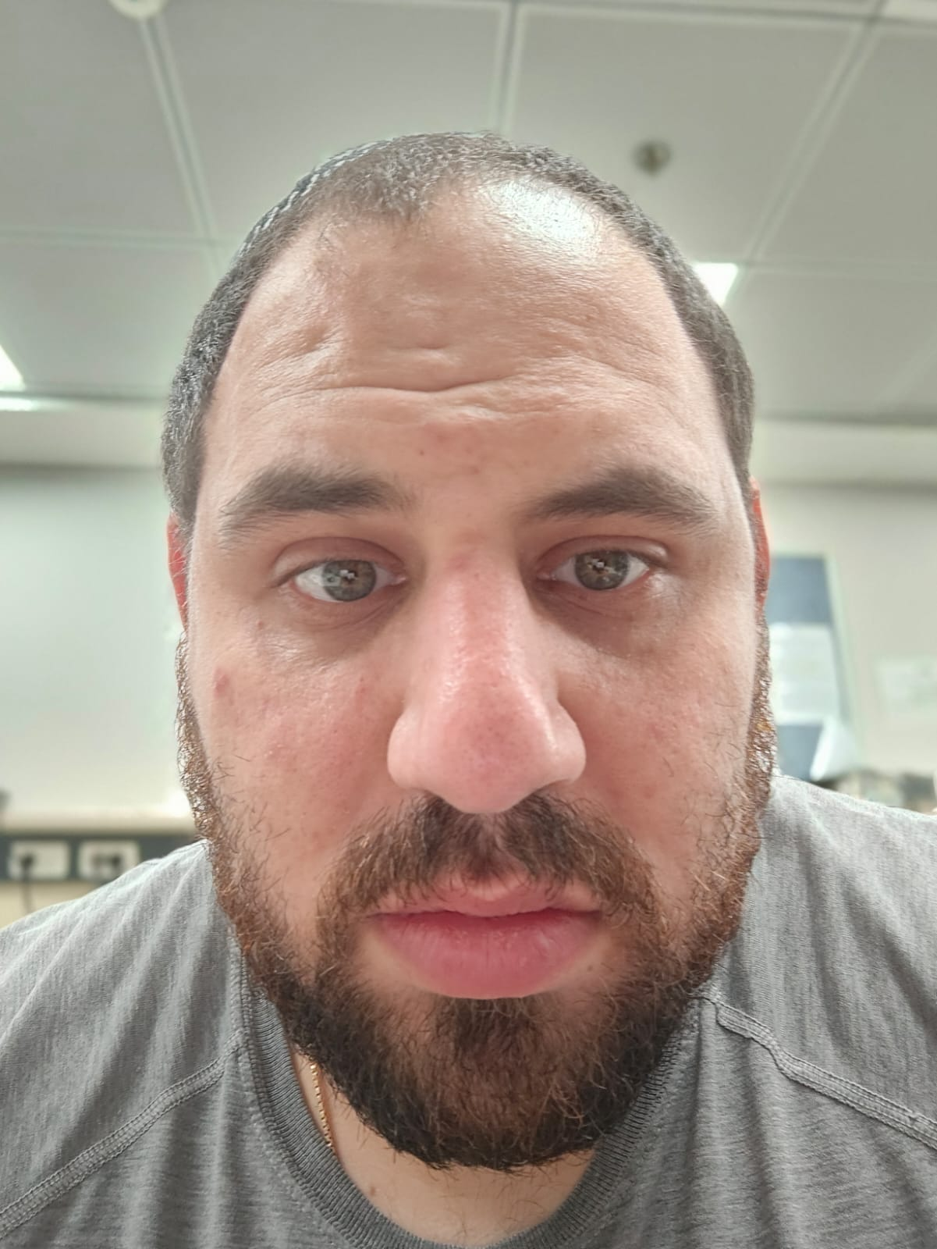
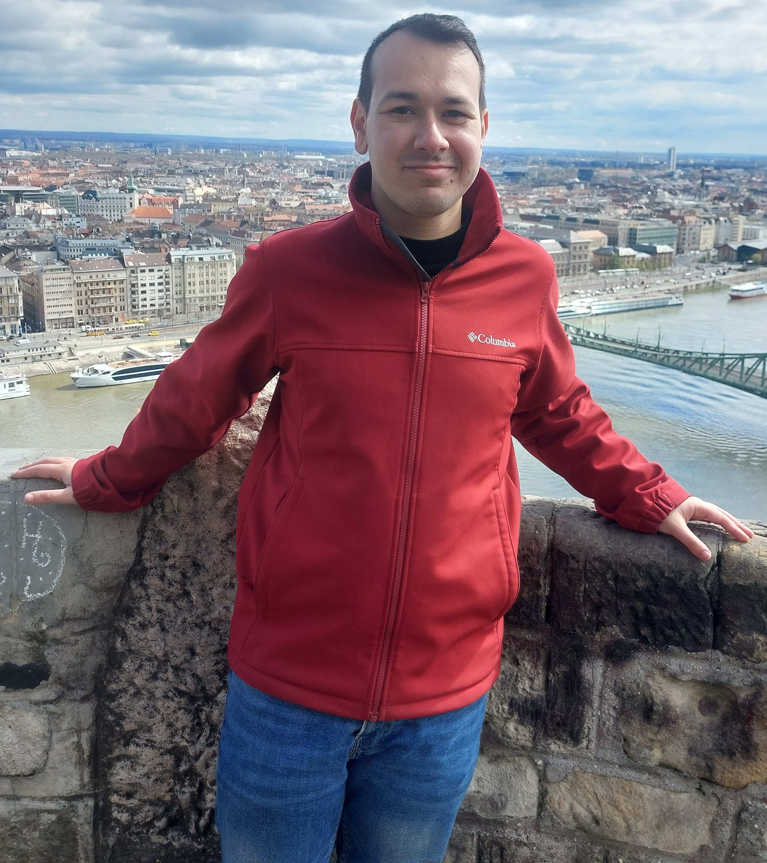

Course: Image Processing 31651
Assignment #24
Pixel to Pixel Operations (Part 4) – version 2
1
Photo of the student | Shorten Name | ID (4 last digits)
 | shienfeld | 1950 | Student #1
 | pony | 2210 | Student #2
 | akimov | 7939 | Student #3
Photo of the student | Shorten Name | ID (4 last digits)
 | shienfeld | 1950 | Student #1
 | pony | 2210 | Student #2
 | akimov | 7939 | Student #3

Slide 2
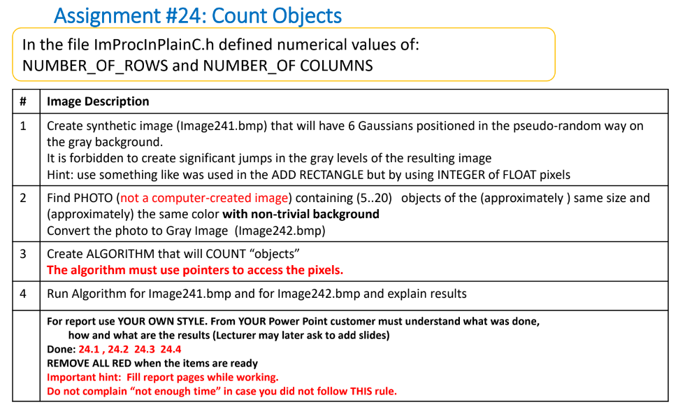
Pay attention : due to the complexity of the code and the complexity of the order of operations in the code – the functions will be explained first and only after that the connectivity to the task will be explained. Every function will be explained as an “isolated part” of the entire program.

Slide 3
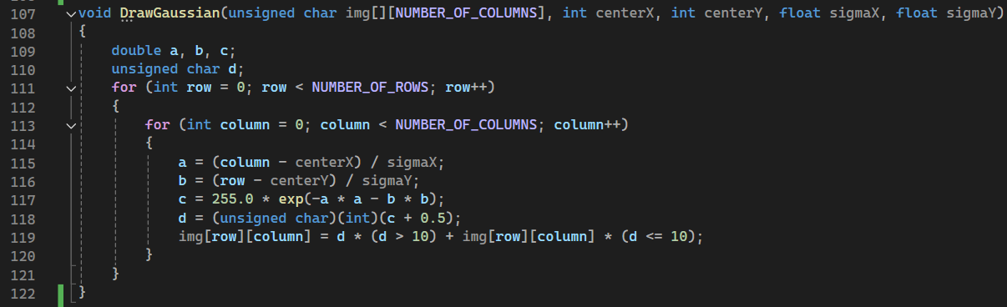
24.1 – “DrawGaussian” function
The DrawGaussian function is designed to add a Gaussian distribution to an image at specified coordinates.
For each pixel located at (row, column), the function calculates the value of the Gaussian distribution at that point.
a and b are the normalized distances from the center of the Gaussian in the x and y directions, respectively.
The Gaussian value c is then calculated using the formula for a 2D Gaussian distribution:
d is the Gaussian value rounded to the nearest integer.
The function updates the pixel value at (row, column) in the image array img:
If the calculated Gaussian value d is greater than 10, the pixel value is updated to d. If d is less than or equal to 10, the pixel value remains unchanged.

Slide 4
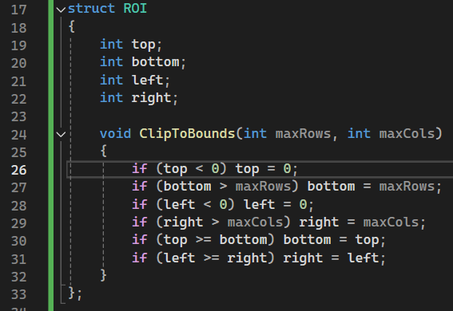
24.2 – “ROI (region of interest)” struct
The primary purpose of the ROI struct is to define a rectangular area within an image where certain operations will be applied.
This allows focusing on specific parts of the image rather than processing the entire image.
void ClipToBounds is a method to ensure the ROI is within the bounds of the image. It adjusts the top, bottom, left, and right properties to make sure they do not exceed the image dimensions.
Summary : we created the ROI as a useful tool for later counting operation (of objects or gaussians). In the next slides the usefulness of the ROI will be clarified!

Slide 5
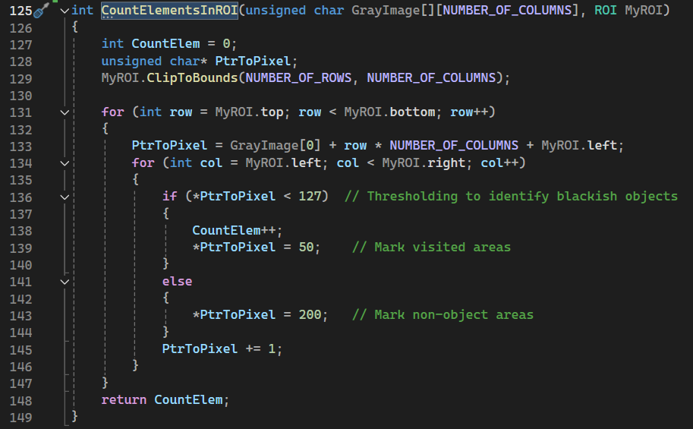
24.3 – “CountElementsInROI” function – part 1
This function is designed to count the number of elements (or objects) within a specified region of interest (ROI) in a grayscale image. It also modifies the image to mark visited areas.
This variable will store the count of elements (objects) found within the ROI.
Inside the inner loop, each pixel within the ROI is checked and processed
The function checks if the pixel value is less than 127 (a mid-gray value). This threshold is used to identify "blackish" objects or areas that are darker than the threshold.
A deeper explanation about the checking process will be presented next slide

Slide 6
24.3 – “CountElementsInROI” function – part 2
The function checks if the pixel value is less than 127 (a mid-gray value).
This threshold is used to identify "blackish" objects or areas that are darker than the threshold.
If the pixel is below the threshold (i.e., part of an object), CountElem is incremented, indicating that an element has been found.
If the pixel is not part of an element (i.e., its value is 127 or greater), it is marked with a value of 200. This marking can help differentiate between processed and unprocessed areas of the image.
The pixel value is then set to 50, marking it as "visited." This prevents the function from counting the same pixel multiple times in future iterations.
The function works within the specified ROI and ensures that the ROI does not exceed the image boundaries. (using ClipToBounds method)

Slide 7
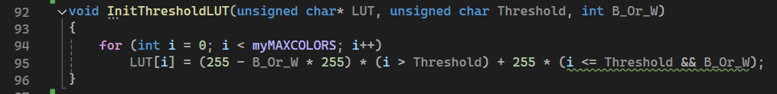
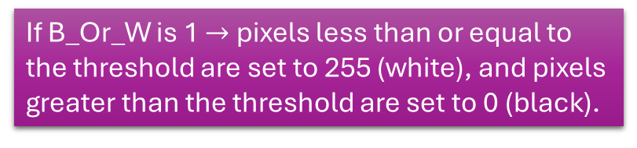
24.4 – “InitThresholdLUT” function
The InitThresholdLUT function initializes a Lookup Table for thresholding a grayscale image.
The LUT is used to map the pixel values based on a specified threshold, either making them black or white depending on whether they are above or below the threshold.
Pay attention – one of the input of the function is a pointer to the LUT which was defined as global.
B_Or_W is a flag that determines the output value for pixels based on the threshold
If B_Or_W is 1 $→$ pixels less than or equal to the threshold are set to 255 (white), and pixels greater than the threshold are set to 0 (black).
If B_Or_W is 0, pixels less than or equal to the threshold are set to 0 (black), and pixels greater than the threshold are set to 255 (white).

Slide 8
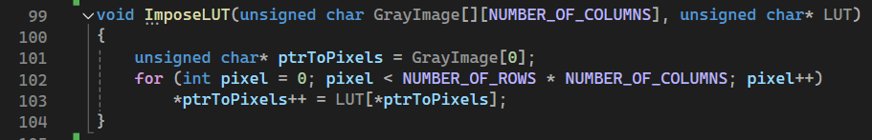
24.5 – “ImposeLUT” function
After defining the LUT – we need to apply the LUT on the gray image.
ptrToPixels is initialized to point to the first pixel of the image.
Since GrayImage is a 2D array, GrayImage[0] points to the first row, and ptrToPixels thus points to the first pixel in that row.

Slide 9
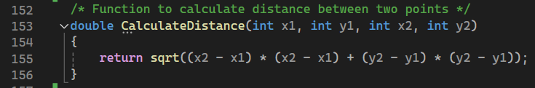
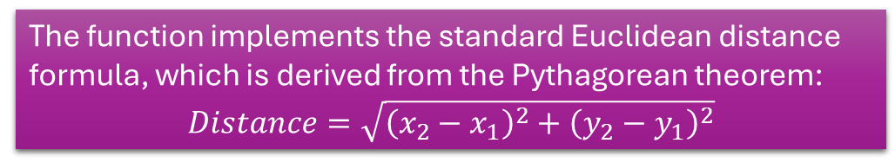
24.6 – “CalculateDistance” function
That is a straightforward utility function that calculates the Euclidean distance between two points in a 2D plane.
The function implements the standard Euclidean distance formula, which is derived from the Pythagorean theorem:
$$Distance=\sqrt{{\left(x_{2}−x_{1}\right)}^{2}+{\left(y_{2}−y_{1}\right)}^{2}}​$$

Slide 10
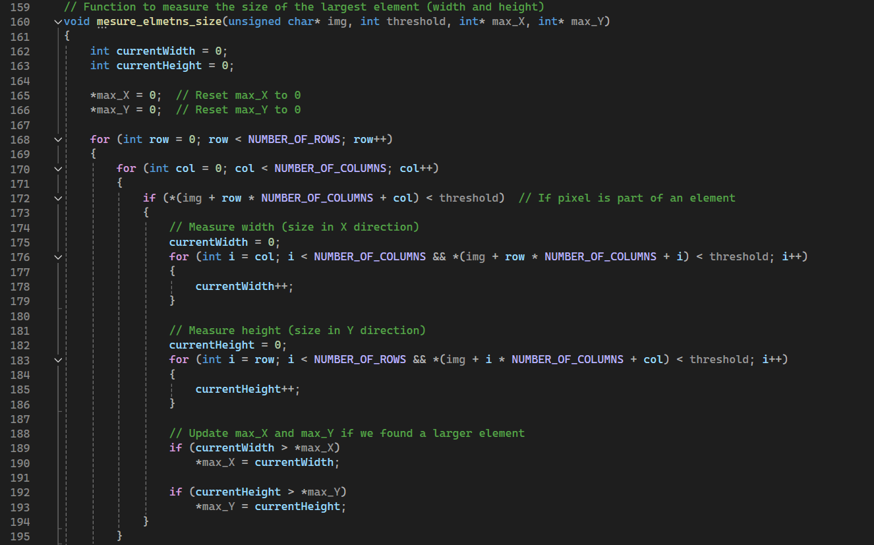
24.7 – “mesure_elmetns_size” function
designed to measure the size of the largest element in a binary or thresholded grayscale image. Specifically, it calculates the width and height of the largest contiguous region of pixels that are below a specified intensity threshold.

Slide 11
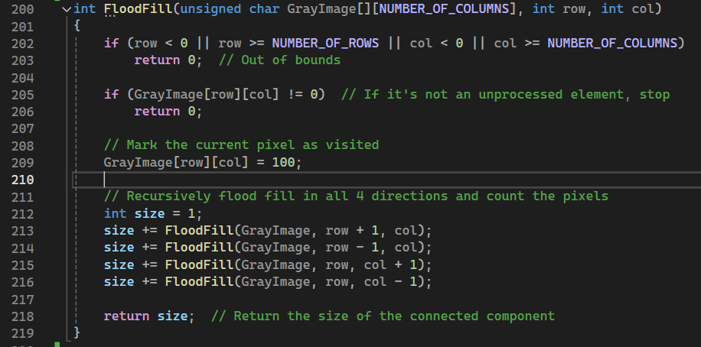
24.8 – “FloodFill” function
The purpose of the floodfill function is to find and label connected components (or regions) within an image. It starts from a given pixel and "fills" all connected pixels that belong to the same component, marking them as visited and counting them as part of the region.
The function uses recursion to explore all four directions (up, down, left, right) from each pixel, ensuring that the entire component is filled and measured.
Pixels that are part of the filled region are marked with a value of 100 to indicate that they have been processed, preventing the function from counting them again.
The function returns the total size of the connected component, which is the number of pixels that were part of the filled region.

Slide 12
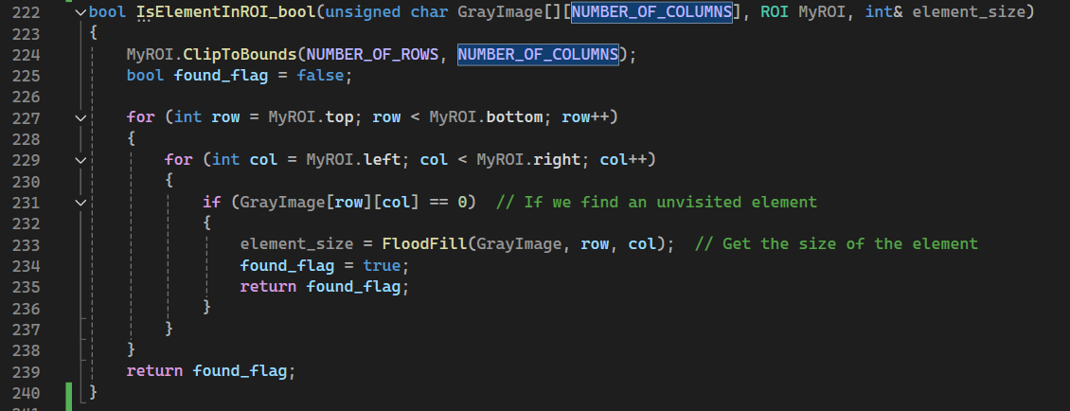
24.9 – “IsElementInROI_bool” function
That function is designed to check if there is any unvisited element (or object) within a specified region of interest (ROI) in a grayscale image. If an element is found, it uses the FloodFill function to calculate the size of that element and returns a boolean indicating whether an element was found.
The function returns a bool. It returns true if an element is found within the ROI and false if no element is found.

Slide 13
Introduction to 24.10– otsu method for threshold – part 1
We didn’t study in the course that method – we studied it alone for solving that lab the best possible way
Otsu's method is a technique used in image processing for automatic threshold selection.
The main idea is to find the threshold that best separates the pixels of an image into two classes: the foreground (e.g., objects of interest) and the background.
This method is particularly useful for converting a grayscale image into a binary image - where pixels are categorized as either black (foreground) or white (background).

Slide 14
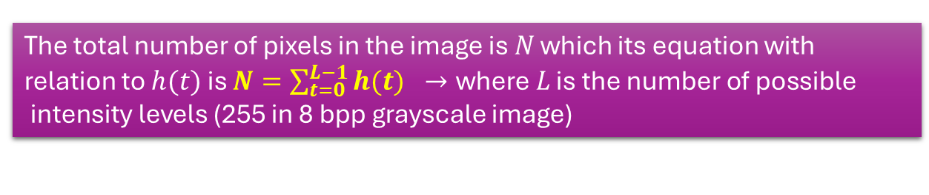
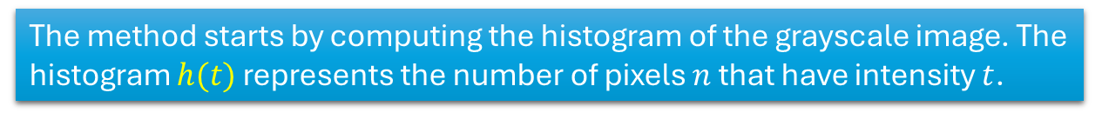
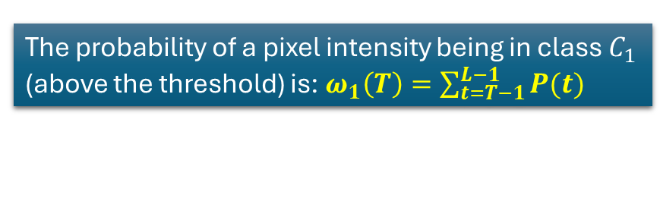
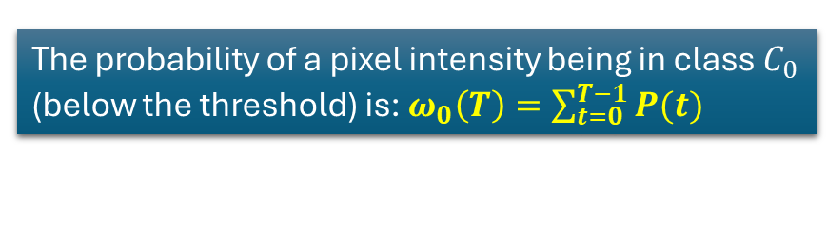
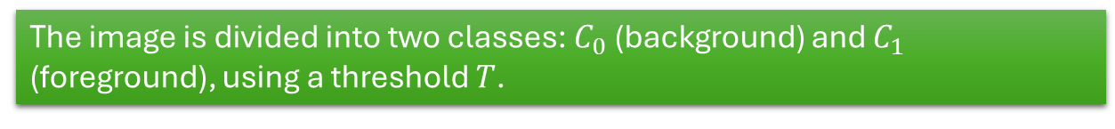
Introduction to 24.10– otsu method for threshold – part 2
The method starts by computing the histogram of the grayscale image. The histogram $h(t)$ represents the number of pixels $n$ that have intensity $t$.
The total number of pixels in the image is 𝑁 which its equation with relation to $h(t)$ is $N=\sum_{t=0}^{L−1}{h(t)} →\text{where} L \text{is} \text{the} \text{number} \text{of} \text{possible} \text{intensity} \text{levels}$ (255 in 8 bpp grayscale image)
The image is divided into two classes: $C_{0}$ (background) and $C_{1}$ (foreground), using a threshold $T$.
The probability of a pixel intensity being in class $C_{0}$ (below the threshold) is: $ω_{0}\left(T\right)=\sum_{t=0}^{T−1}{P(t)}$
The probability of a pixel intensity being in class $C_{1}$ (above the threshold) is: $ω_{1}\left(T\right)=\sum_{t=T−1}^{L−1}{P(t)}$
Where $P(t)$is the probability of intensity level $t$, calculated as $P\left(t\right)=\frac{h\left(t\right)}{N}$

Slide 15
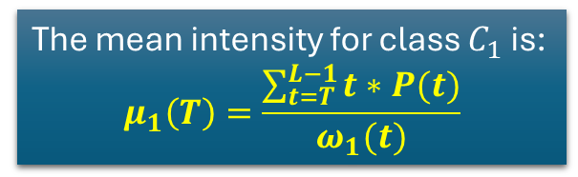
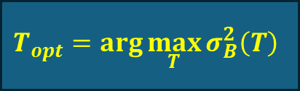
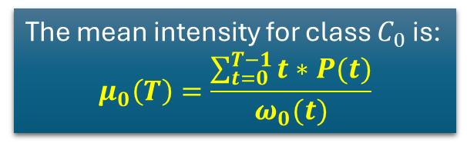


Introduction to 24.10– otsu method for threshold – part 3
The mean intensity for class $C_{0}$ is:
$$μ_{0}\left(T\right)=\frac{\sum_{t=0}^{T−1}{t∗P(t)}}{ω_{0}(t)}$$
The global mean intensity of the image is:
$$μ=\sum_{t=0}^{L−1}{t∗P(t)}$$
The mean intensity for class $C_{1}$ is:
$$μ_{1}\left(T\right)=\frac{\sum_{t=T}^{L−1}{t∗P(t)}}{ω_{1}(t)}$$
The between-class variance is defined as:
$$σ_{B}^{2}\left(T\right)=ω_{0}\left(T\right)∗ω_{1}\left(T\right)∗[μ_{0}\left(T\right)−μ_{1}\left(T\right)]$$
Otsu’s method selects the threshold $T$ that maximizes this between-class variance $σ_{B}^{2}\left(T\right)$.
The rationale is that a larger between-class variance indicates better separation between the two classes.
$$T_{opt}=\arg{\max_{T}{σ_{B}^{2}\left(T\right)}}$$

Slide 16
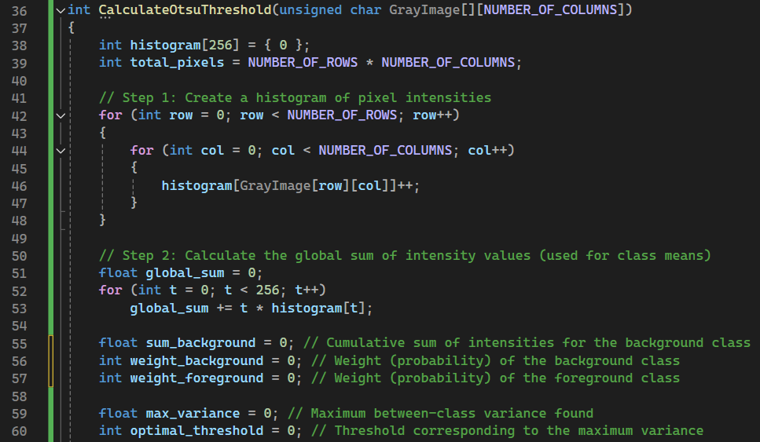

24.10 – “CalculateOtsuThreshold” function – part 1
Compute the Histogram of pixels intensities and compute the total number of pixels in the image
Compute the global mean intensity of the image $μ$

Slide 17
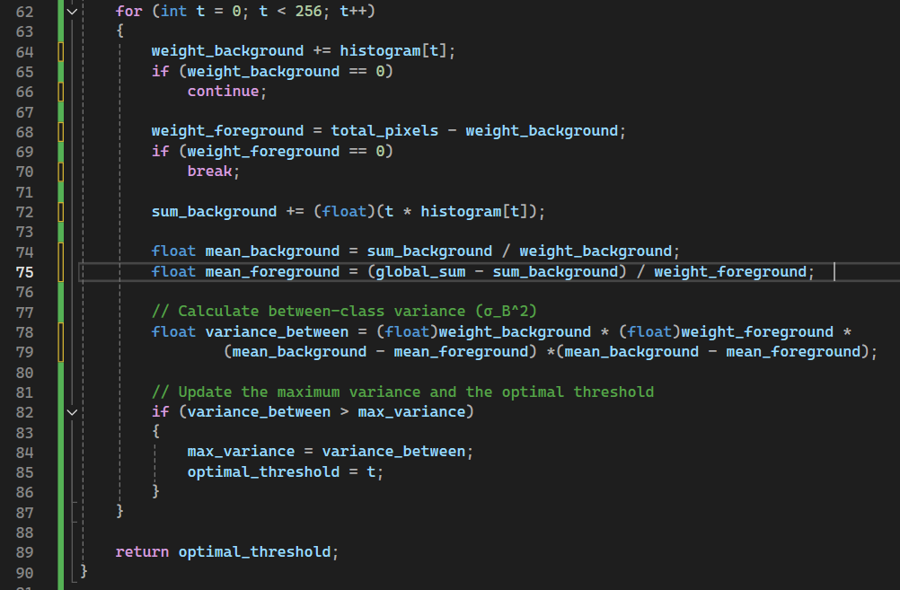


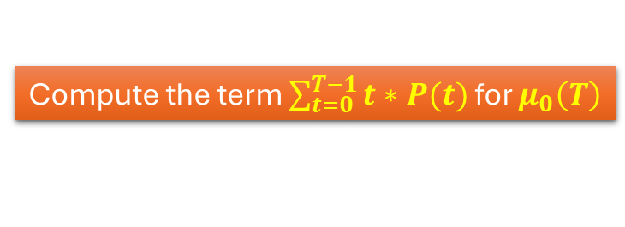

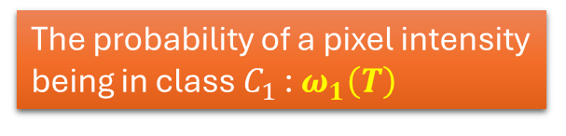
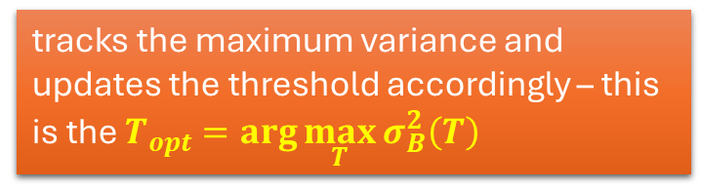
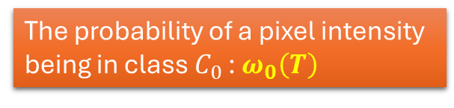
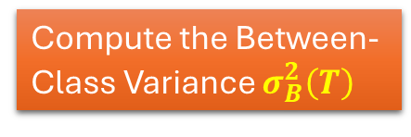
24.10– “CalculateOtsuThreshold” function – part 2
The probability of a pixel intensity being in class $C_{0}$ : $ω_{0}\left(T\right)$
The probability of a pixel intensity being in class $C_{1}$ : $ω_{1}\left(T\right)$
Compute the term $\sum_{t=0}^{T−1}{t∗P(t)}$ for $μ_{0}\left(T\right)$
Compute $μ_{0}\left(T\right)$
Compute $μ_{1}\left(T\right)$
Compute the Between-Class Variance $σ_{B}^{2}\left(T\right)$
tracks the maximum variance and updates the threshold accordingly – this is the $T_{opt}=\arg{\max_{T}{σ_{B}^{2}\left(T\right)}}$
Return $T_{opt}$

Slide 18
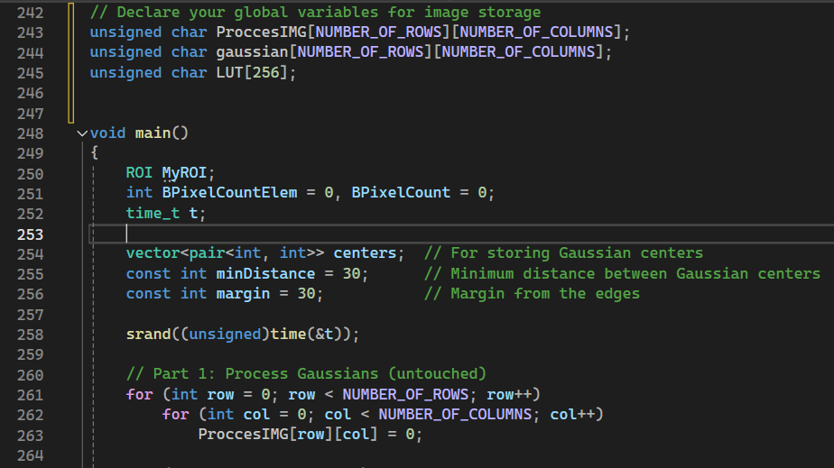
24.6 – “main” function – part 1
A 2D array used to store the processed image.
Another 2D array similar to ProccesIMG, used to store a Gaussian distributions – for the counting process
A lookup table (LUT) with 256 entries
seeds the random number generator using the current time. This is crucial for ensuring that any subsequent calls to rand() produce different sequences of random numbers each time the program runs.
Each pixel in the ProccesIMG array is initialized to 0

Slide 19
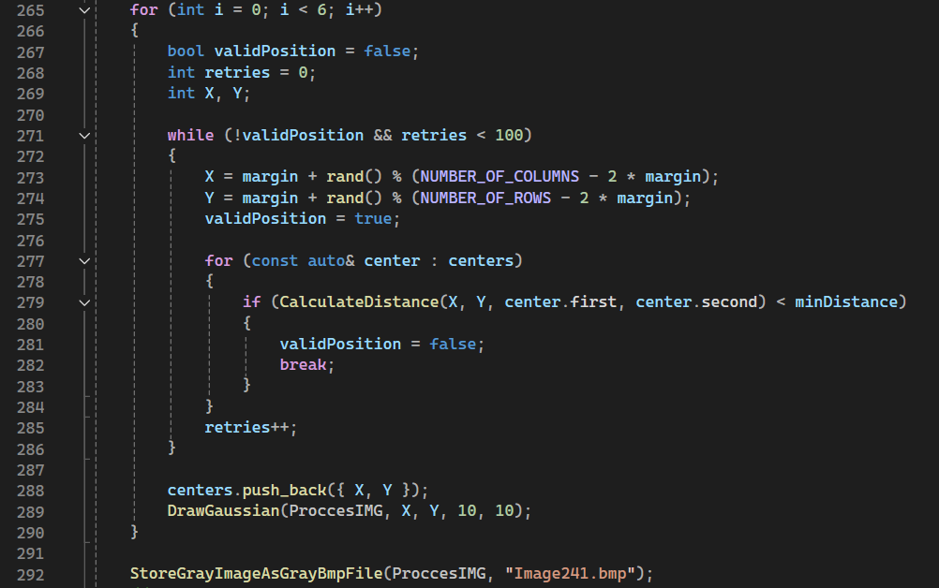
24.6 – “main” function – part 2
The loop iterates 6 times, aiming to place 6 Gaussian distributions on the image.
This loop keeps trying to find a valid position for the Gaussian center until it finds one or reaches 100 retries
The x and y coordinates of the Gaussian center are randomly generated within the boundaries defined by the margin. This ensures the center is not too close to the edges of the image.
This function call calculates the Euclidean distance between the newly proposed Gaussian center (X, Y) and each previously placed Gaussian center.
This function call draws a Gaussian distribution centered at (X, Y) on the ProccesIMG image.

Slide 20
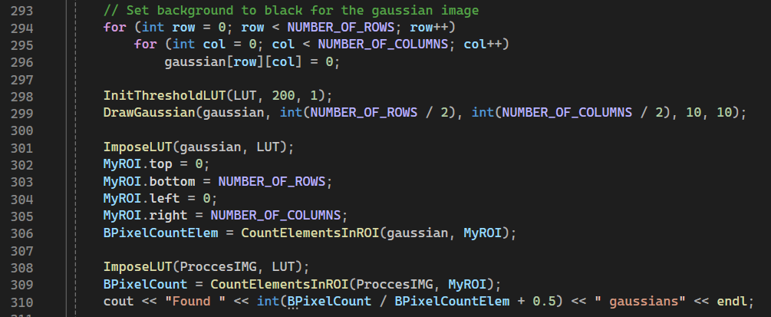
24.6 – “main” function – part 3
This part of the main function deals with creating and processing a Gaussian image, applying a threshold, and counting elements within the image.
This function counts the number of elements (objects) within the specified ROI of the gaussian image.
And the same for th processIMG
This division gives an estimate of how many Gaussian-like elements are present in the processed image by comparing the total element count in the processed image to the count in the Gaussian image (a single gaussian)

Slide 21
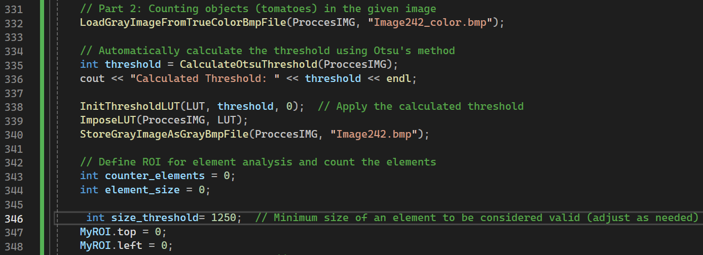
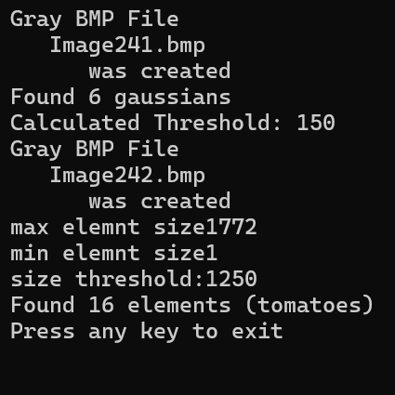
24.6 – “main” function – part 4
This part of the “main” is focused on loading an image, determining the threshold and applying it. Finally the image after threshold has been applied is saved as Image242.bmp
The CalculateOtsuThreshold function automatically determines an optimal threshold value for converting the grayscale image into a binary image (black and white) using Otsu's method.
Initializes the lookup table (LUT) using the threshold value calculated by Otsu's method. pixels below the threshold should be set to black (0)
The size of threshold was determined by examine the size of our elements.
We can see from image of the program’s buffer that the max size is 1772 while the min size is 1 pixel. Base of the knowledge of academic student and without using machine learning algorithms this threshold need to be inserted manually.

Slide 22
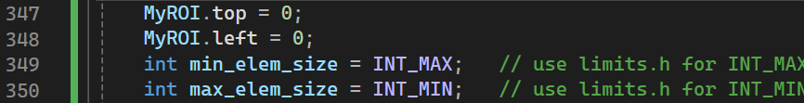
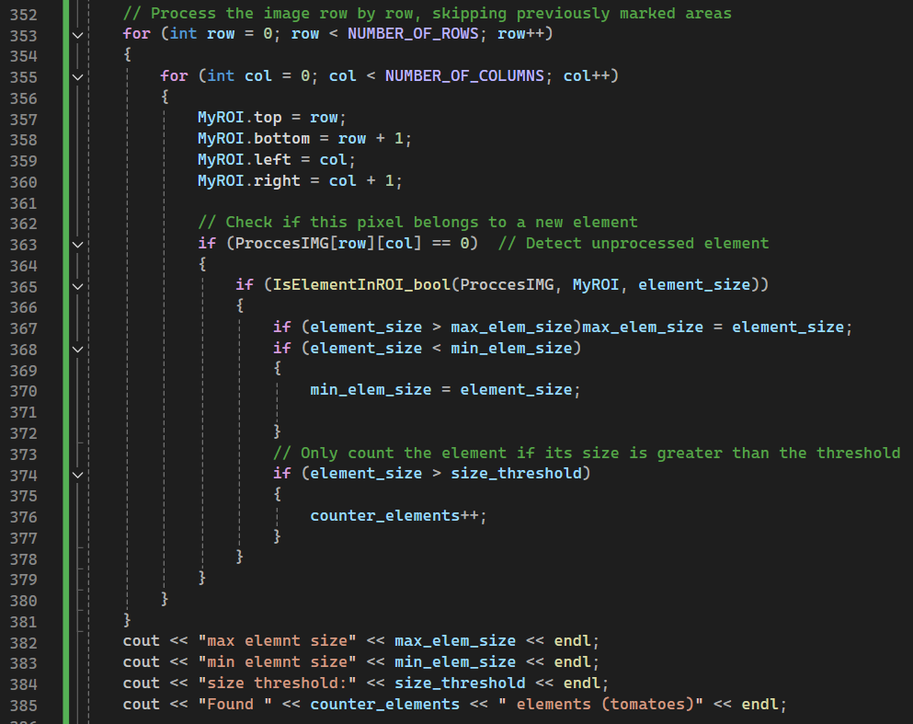
24.6 – “main” function – part 5
For search the minimum and maximum size of an elment.
The region of interest (MyROI) is set to the current pixel being processed. This essentially defines a 1x1 pixel area around the current pixel.
This function checks if there is an element (connected component) in the region of interest (MyROI). If an element is found, the function returns true and updates element_size with the size of the element.
This prevents counting very small elements that might be noise or irrelevant details.

Slide 23
Image242_color.bmp
24.7 – flow chart of the code– part 1
input
LoadGrayImageFromTrueColorBmpFile
Loaded image into ProccesIMG
Only if the element is above threshold that pre-checkd the elemtn will be counted
input
IsElementInROI_bool
Output: threshold (optimal threshold value)
CalculateOtsuThreshold
output
input
Nested for loop with dynamic region of interest to find the element
input
Number of elements found
input
Empty LUT [256]
InitThresholdLUT
Output:size of the elment
input
ImposeLUT
Output: LUT (initialized for thresholding)
Loop through each pixel in ProccesIMG
FloodFill
Output : ProccesIMG after applying the LUT
StoreGrayImageAsGrayBmpFile

Slide 24
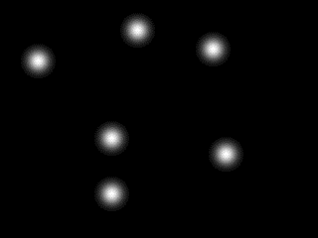

24.8 – created images and the counting results – part 1
Image241.bmp
The printing of the program indicate that 6 gaussian elements were found!
In addition – the profilers confirm that true gaussians were created.
Pay attention that I made sure that the created gaussians will be independent – AKA no overlapping or clipping – for preventing any chance of wrong counting!
This is the number I demanded!

Slide 25
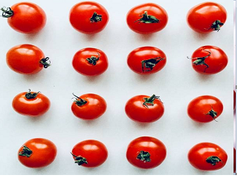
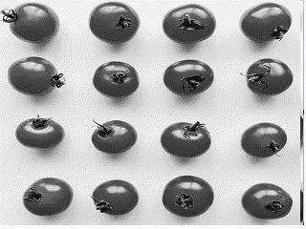
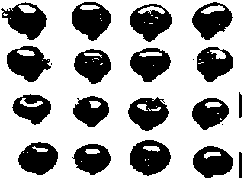
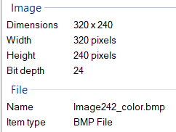
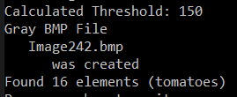
24.8 – created images and the counting results – part 2
Image242_color.bmp
Image242_gray.bmp → for debugging only
input
Image242_gray.bmp
This is the result after applying the threshold algorithm– we did it for easier understanding of how to count the objects and how to distinguish the element from the background.

Slide 26
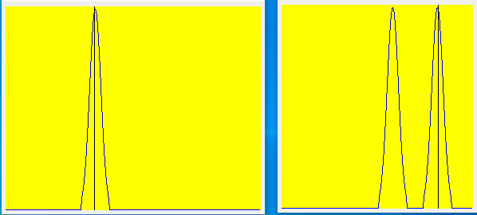
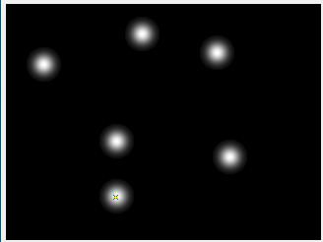
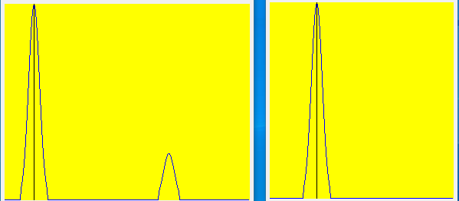
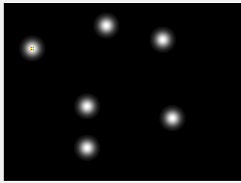
24.9 – created images' profiles– part 1
Inspection points

Slide 27
24.10 – what did we learn?
We learned how to count similar objects with similar shape and color in a photo using binary threshold method (under known background)
2. We learned how to use uniform distribution for getting random values
3. We learned how to create random gaussians
4.We learned how to use struct of ROI to achieve better recognition of an element based on previous knowledge (approximate size of the element.)

